Slide 1

Annual Report
Performance, Evaluation & Improvement Committee
Fiscal Year 2023
July 1, 2022 – June 30, 2023
Page 5

Slide 2
Table of Contents
Client Population Insights…………….............................................................. Page 3-5
Care Coordination………………………………………………………………………………….. Page 6
Health Screening……………………………………………………………………………………. Page 7
Care Transitions…………………………………………………………………………..…………. Page 8
Healthy Living Course…………………………………………………………………………..… Page 9
Substance Use Prevention……………………………………………………..………………. Page 10
Client Satisfaction Surveys………………………………………................................ Page 11
Page 6

Slide 3
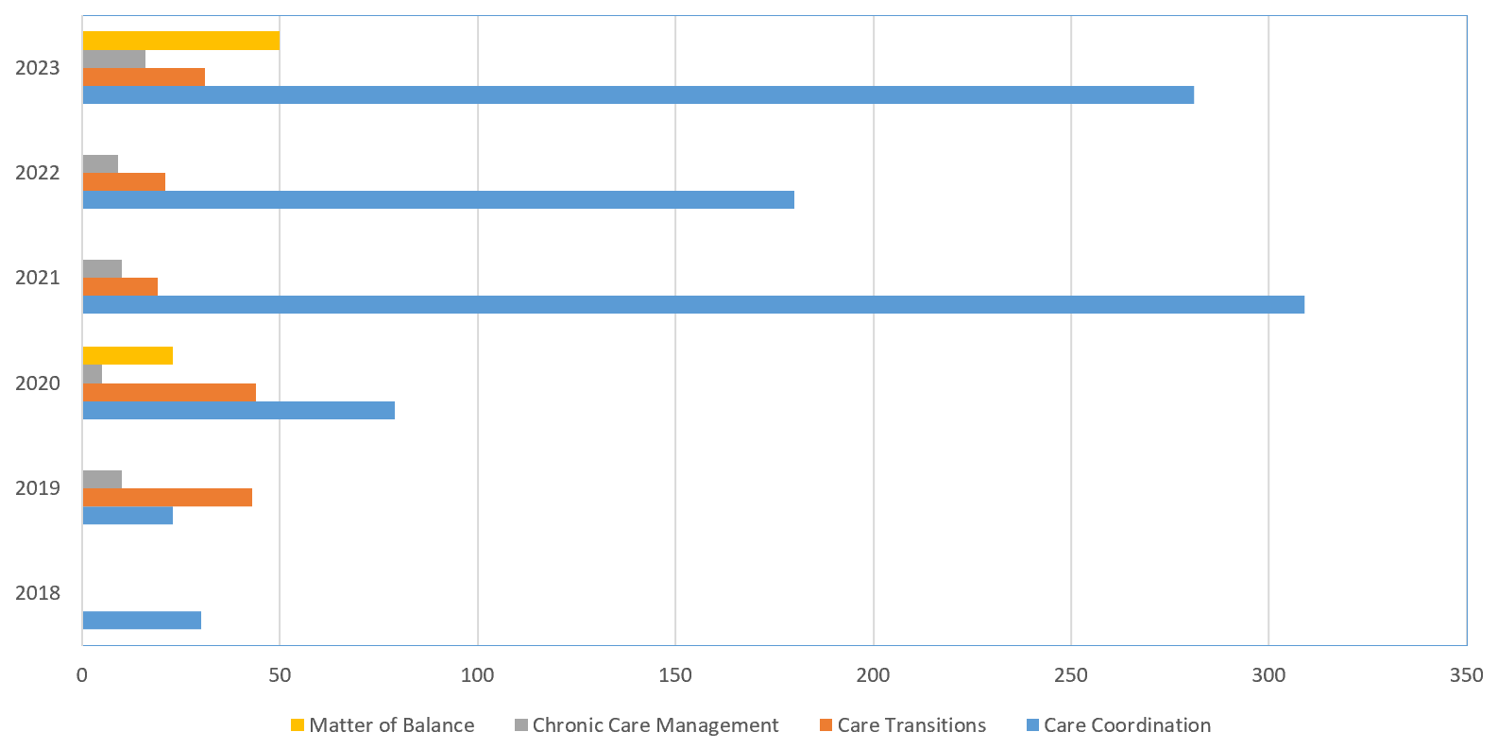
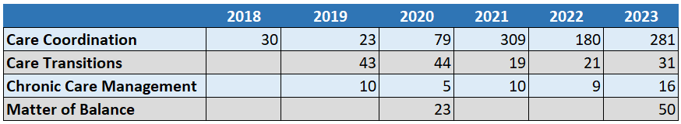
Client Population Insights (1 of 3)
Client Population by Program and Year
All data is displayed by FY
After a COVID hiatus, Matter of Balance classes relaunched to great interest in FY2023.
Since the first quarter of FY2023, only two clients have required COVID-related assistance.
18 clients have worked to address SUD with our Community Health Worker specializing in peer support hired in early FY2023.
Our peer support specialist has also hosted 37 peer support group meetings, open to clients and all other community members, averaging four attendees per group.
Page 7

Slide 4
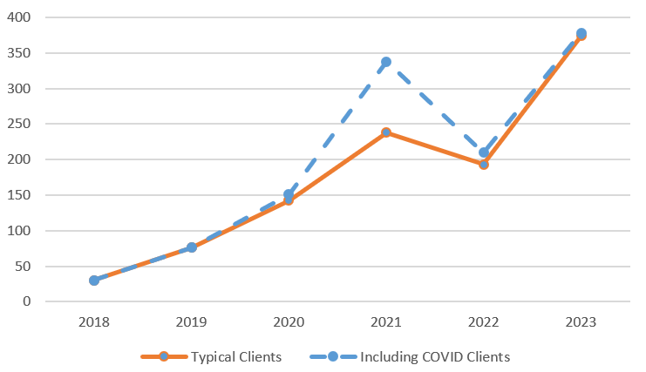
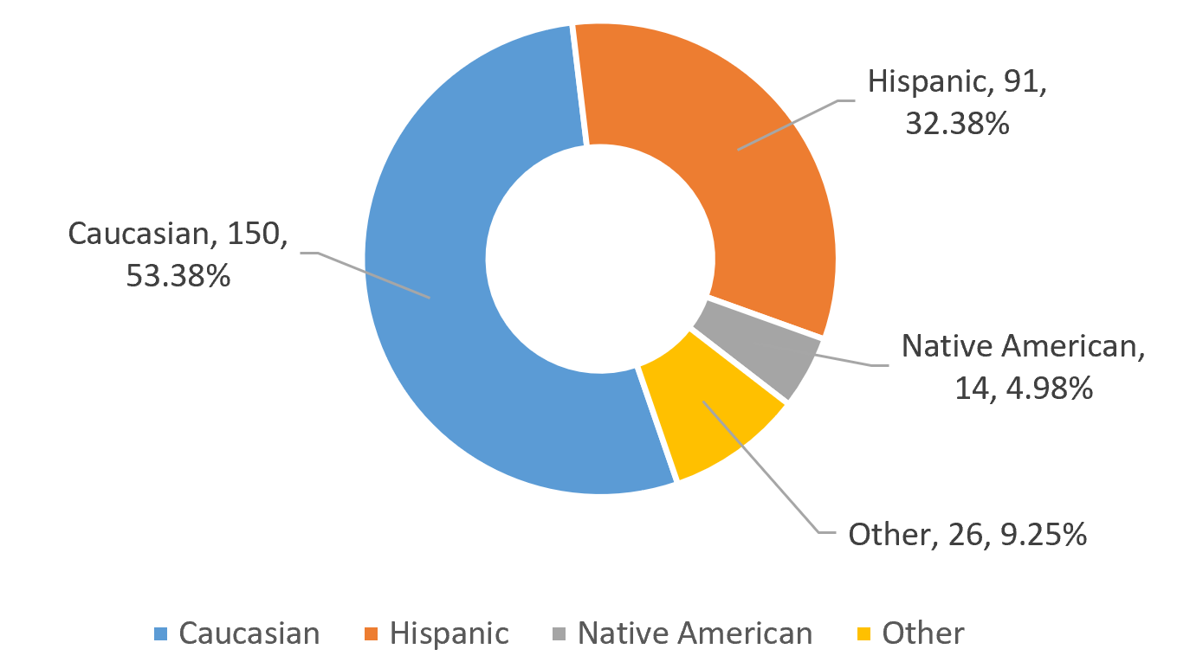
Client Population Insights (2 of 3)
Client Count by Fiscal Year
FY2023 Clients by Race
These data includes the total # of clients per fiscal year for the following programs: Care Transitions, Care Coordination, the Healthy Living Course and Matter of Balance. Other programs such as Health Screenings, Community Education Workshops, drug take-back events and prevention education curriculum are not included.
Due to small counts, African-American, Bi-Racial, Declined to State, and Other Race were all included in “Other.”
Page 8

Slide 5
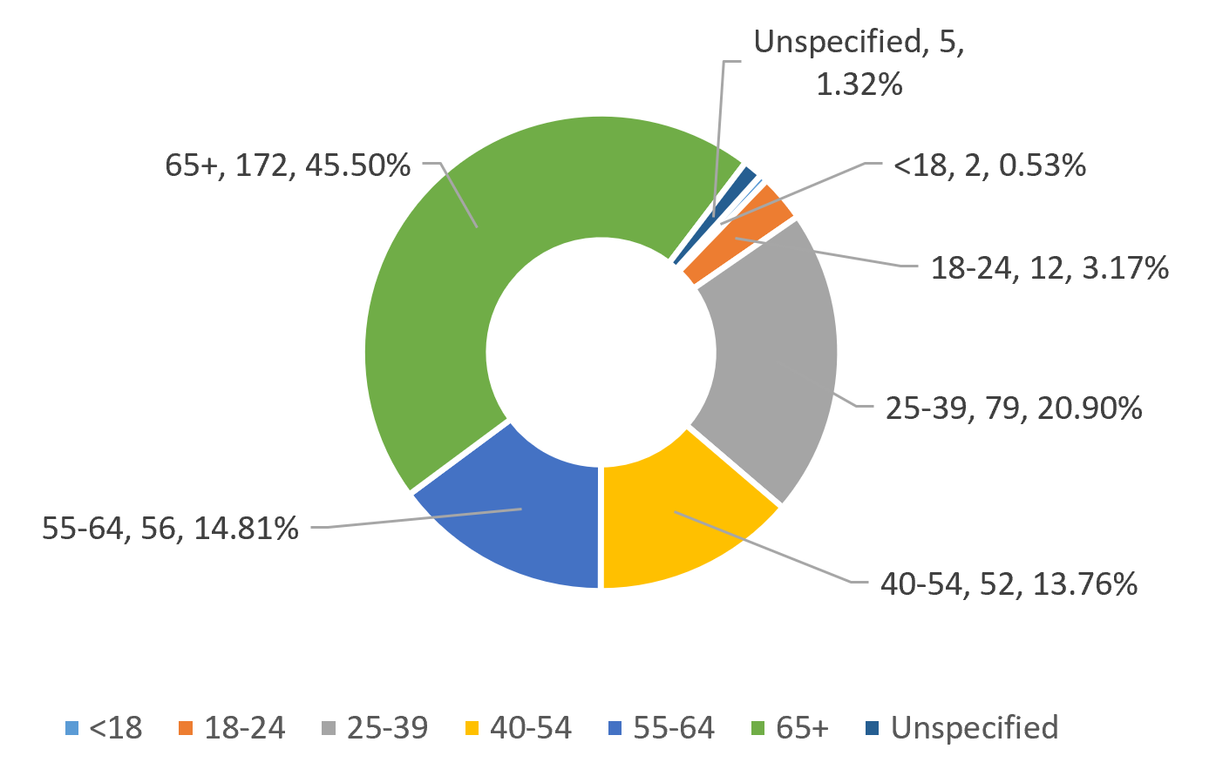
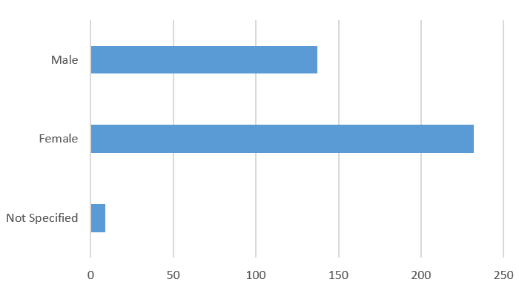
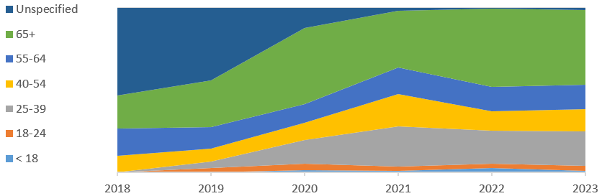
Client Population Insights (3 of 3)
FY2023 Clients by Age
FY2023 Clients by Gender
25%
74%
36%
15%
74%
Percent of Clients in Age Group by Fiscal Year
21%
3%
Over time, MHA has improved it’s gathering of demographics and may have begun serving more clients aged 25-39 and 65+, but data limitations in earlier years make it hard to be certain.
Page 9

Slide 6
Care Coordination – Program Specific Data FY2023
Top three
FY23 client engagement activities: patient advocacy, client appointments, home visits
14%
of clients were referred to addiction and/or behavioral health services.
31%
of our patient advocacy activities were assisting clients experiencing SUD.
18%
of our Care Coordination clients were experiencing SUD.
24
new patients established at RCMS through MHA referrals in FY23.
We distributed 1,574 home COVID tests throughout the community. As COVID waned later in the fiscal year there was a significant reduction in requests.
6%
We distributed 351 additional healthy living resources, including glucose monitors, portion plates, scales, and other items.
We distributed 36 Blood Pressure Cuffs at a total cost of $1,260.
This was down from 77 cuffs distributed in FY2022 and our all-time high of of 102 cuffs distributed in FY2021.
12%
25%
55%
39%
33%
25%
25%
22%
16%
25%
4%
2%
3%
Page 10

Slide 7
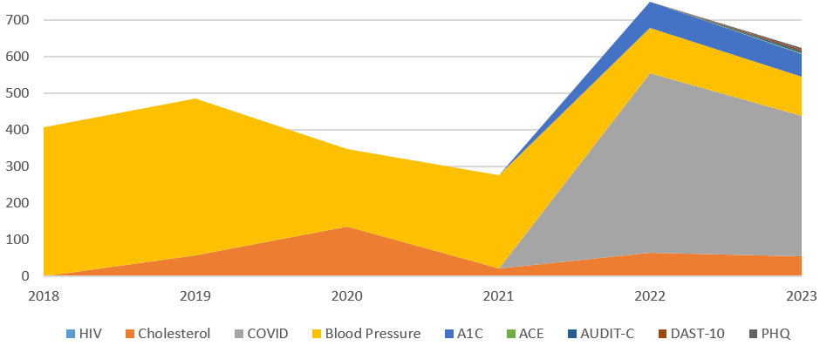
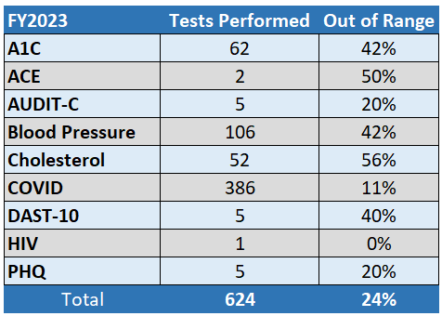
Health Screenings– Program Specific Data FY2023
Health Screenings by Fiscal Year
Several new screening tools were put in place in late FY2023 to support Enhanced Care Management Care Plan development:
Adverse Childhood Experiences (ACE)
Alcohol Use Disorders Identification Test (AUDIT-C)
Patient Health Questionnaire (PHQ), a tool for tool for mental health assessment of depression, anxiety, and other disorders.
Fewer screenings were performed in FY2023. The incidence of out of range screenings was slightly lower for cholesterol and blood pressure and significantly more people were found to have out-of-range A1C - 42% in FY2023 vs 18% in FY2022.
Page 11

Slide 8
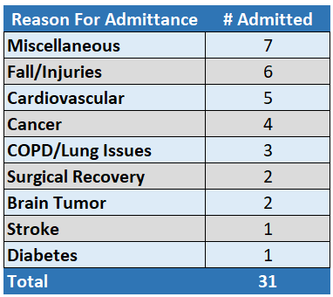
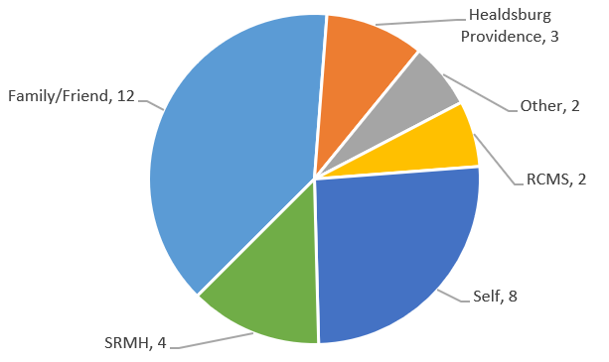
Care Transitions – Program Specific Data FY2023
6.5%
Just 2 of 31 CT clients were readmitted, compared to the Mendocino and Sonoma County average of 14%.
CT clients are
2X
to return to the hospital.
MHA saved the hospital
$360K
In readmission penalties in FY2023
more than
less likely
The total number of CT clients is 148% of last year’s client count.
Referral Source
Page 12
Readmission statistics provided by the Healthcare Cost and Utilization Project, Agency for Healthcare Research and Quality.

Slide 9

Healthy Living Course – Program Specific Data FY2023
MHA provided 162.5 student-hours of Healthy Living instruction.
16 people started the virtual Healthy Living course and 14 graduated.
30 days after completing the class, here’s what our graduates report back…
86% say that they’re using the skills the were taught.
100% think that they’ll use the skills long term.
79% already think that their health has improved.
“I have a little more energy. I feel more confident in general. I'm feeling better physically and emotionally, too.”
“Since the class I am sleeping better & longer … Several from our class still get together and encourage each other. I can’t say enough good things about the Healthy Living course.”
“I've lost 12lbs since the class! It has made other parts of my life become healthier, too. It was so reassuring to hear that other people were having the same experiences as me.”
Page 13

Slide 10

Substance Use Prevention – Program Specific Data FY2023
Rx Take-back Keeps Growing!
School Prevention Ed Is Still Critical
Targeted Narcan Distribution and Double the Training
The number of students receiving prevention education increased again in FY2023 but their experiences remain worrisome.
38% of students in 2023 say their parents & teachers never discuss drugs or addiction, vs. 22% in 2022 and 27% in 2021.
42% of students in 2023 know or aren’t sure if there are opioids in their homes, vs. 47% in 2022 and 52% in 2021.
11% of students in 2023 took pills prescribed for someone else, an improvement of 18% in 2022 and closer to the 12% reported in 2021.
FY2023: 337 lbs. of Rx
Along with community training, in FY2023 we expanded distribution to local businesses and organizations, including the Garcia River Casino and area schools.
FY2022: 213 lbs. of Rx
FY2021: 135 lbs. of Rx
FY2020: 16 lbs. of Rx
2023: 514 Doses Distributed
2022: 674 Doses Distributed
2021: 204 Doses Distributed
FY2023 saw an average of 112 pounds/event, our highest ever and a 158% increase over the prior fiscal year.
2023: 299 People Trained
2022: 145 People Trained
2021: 46 People Trained
Page 14

Slide 11
Client Satisfaction Surveys – FY2023
87%
said their initial visit was very useful.
The remainder said their initial visit was somewhat useful.
What our clients are saying …
“The entire experience was fantastic.”
“... I was also impressed at how quickly MHA moved to claim money and services for our community and then efficiently dispersed it as well. I sing your praises to anyone who will listen.”
“Mendonoma Health helped me maintain my sobriety. Everyone was very helpful and supportive, and went way beyond the call of duty. They helped me mentally and emotionally.
“When I went into early labor with our second child, we were suddenly at a loss for income. We needed money to travel back and forth to the hospital in San Francisco. Mendonoma Health was very helpful to us during a very difficult time. They even made sure we had what we needed for the new baby. It is so wonderful to have this organization in our community.”
90%
rated staff attentiveness and helpfulness as “5” – excellent. Another 8% rated it as a “4”.
80%
report using the information and resources that we provided to them.
99%
said they were likely to recommend others to our services.
Page 15

